Slide 1




Examination of Sample Size Variation and Model Accuracy
Bluelabs Analytics
QMSS Fall 2022 Practicum Project

Slide 2
03
Introduction & Objectives
04
Methodology
Contents
05
Findings
08
Conclusions

Slide 3
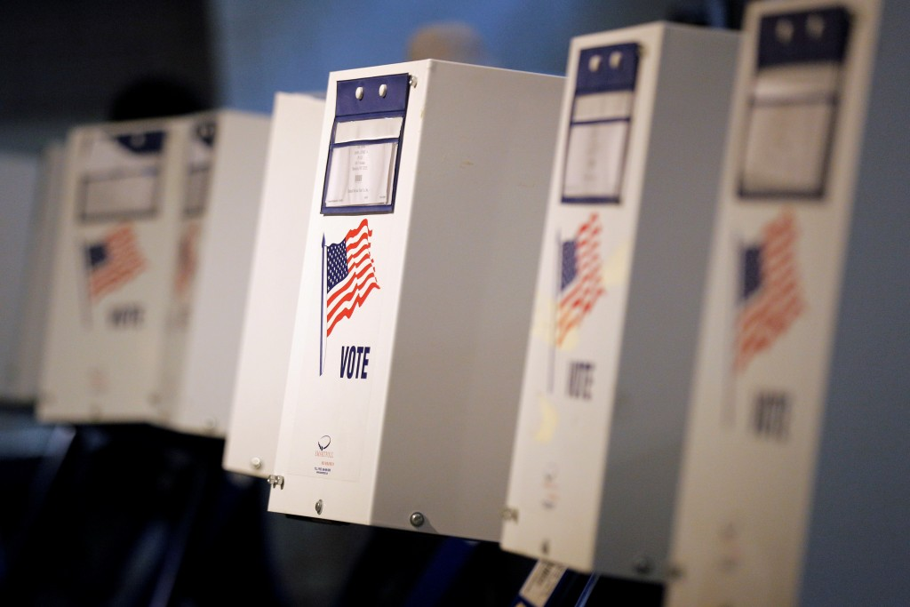

Introduction & Objectives
Build an end-product that can accurately weigh the trade off between sample size and model accuracy
01
Build and refine support models for three types of elections:
2020 Presidential Election (one model each for non-reg and reg states)
2020 Kentucky Senate Election
2021 Virginia Gubernatorial Election
02
Validate models to ensure predictive accuracy on topline sample as well as key groups
03
Conduct sample analysis on above models to determine variation of accuracy rate dependent on n size

Slide 4



Methodology
Data Processing
Initial cleaning of data to remove unnecessary data, impute values, etc.
Subsetting data based upon dependent variables
Recoding of categorical variables and removal of others to address issues of multicollinearity, etc.
Modelling Approach
Created 4 logistic support models, one for each set of election data
Began feature selection process using supervised L1 regression to identify significant features
After manual review and adjustment, imputed these features into Logistic Support Model to form predictions on training, testing, and full data separately
Monte Carlo Simulation
Define a relevant series of sample sizes for each of the four models
For each permutation of sample size:
Generate pulls from the sample population using a stepwise function until maximum n size is reached
For each subset of the sample, control sample population using random seed from 1 to 100
Run relevant logistic support model on each sample
Calculate summary statistics and plot ROC score for each sample size permutation

Slide 5
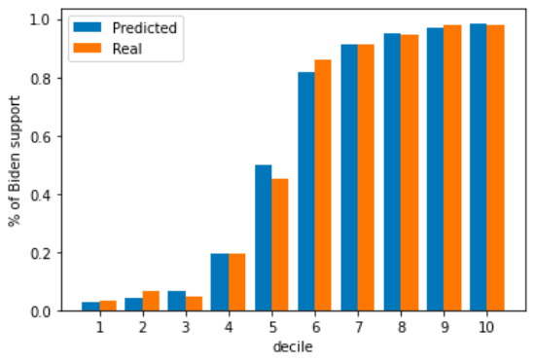
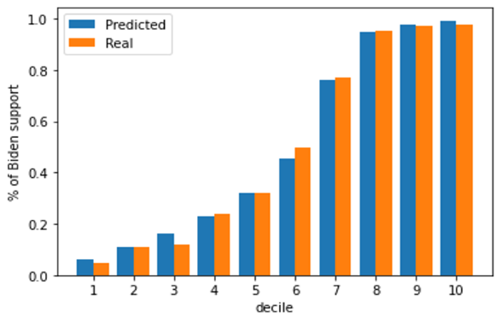
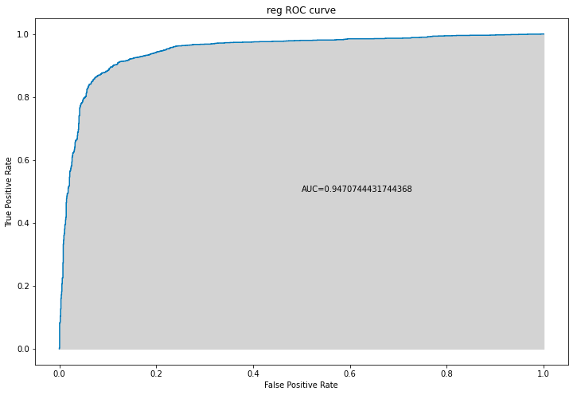
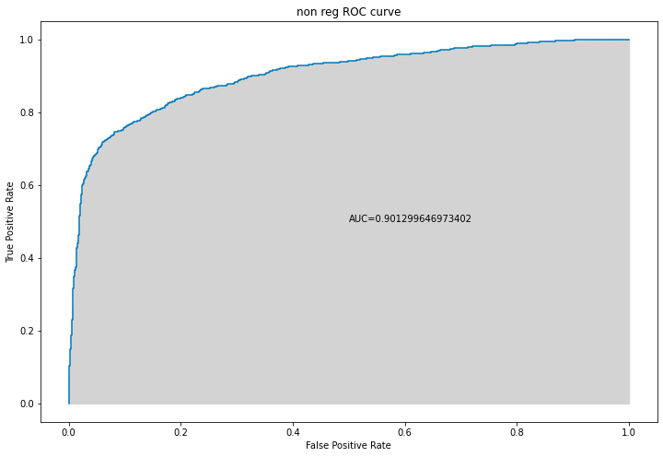
Model Validation
Presidential (Reg)
Presidential (Non-Reg)

Slide 6
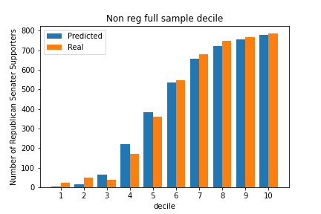
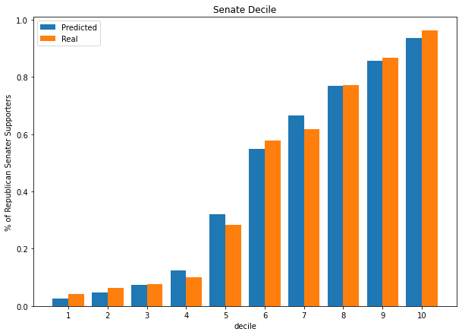
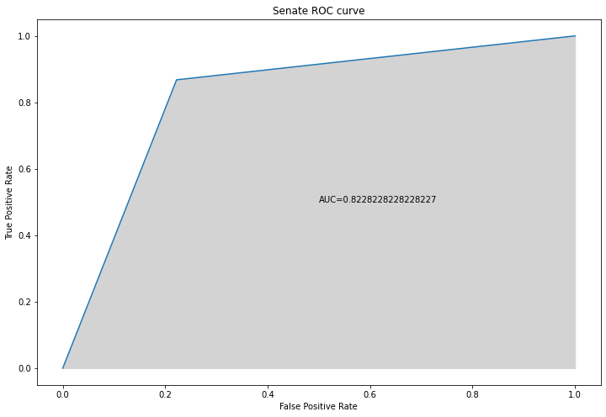
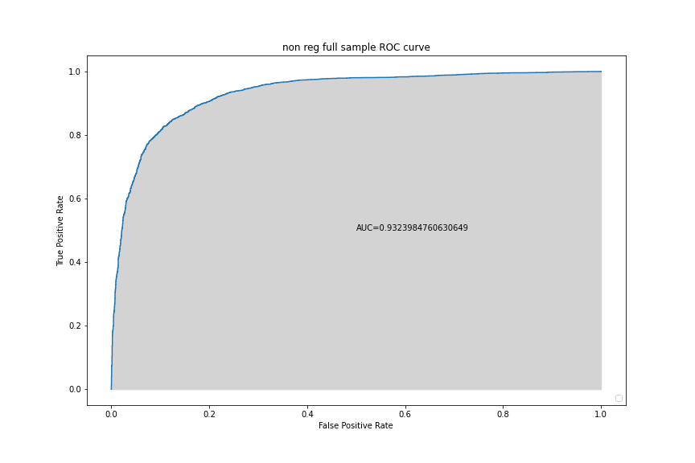
Model Validation (cont.)
Senate
Governor

Slide 7
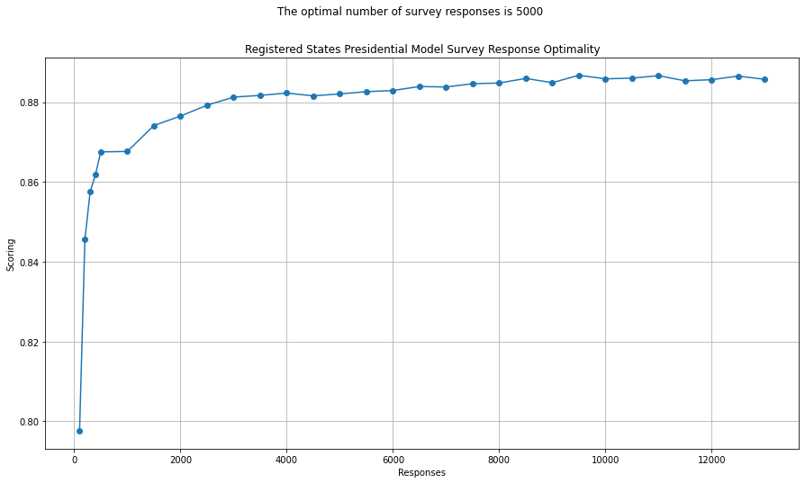
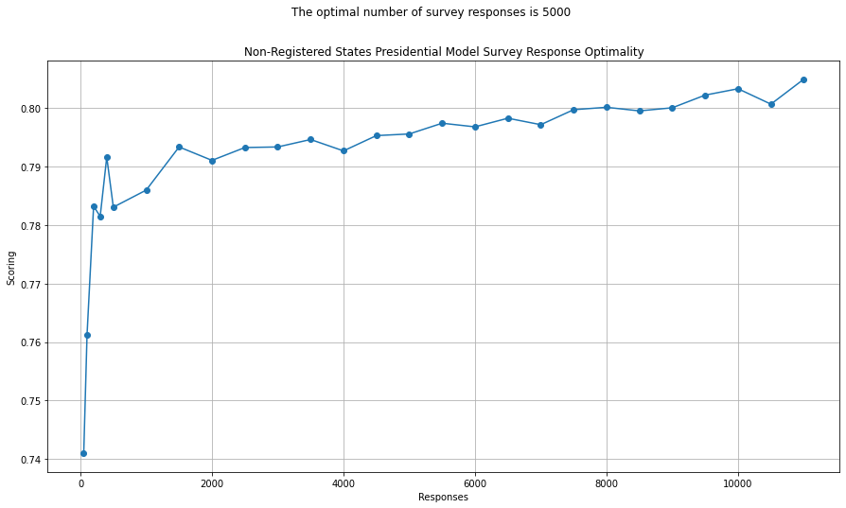
Findings:
Presidential Team
Registered States
Accuracy rate tends to reach a horizontal asymptote at ~90%.
The marginal utility of increasing n size begins to diminish significantly after a sample size of 2000.
An accuracy rate of 85% is possible with a sample as small as 1000.
Non-Registered States
Accuracy rate for non-registered states tends to be lower than registered states, with an upper limit of ~83%.
A similar pattern of decreasing marginal utility at the 2000 mark is also apparent.
An accuracy rate of 79% is possible with a sample of 2000 responses.

Slide 8
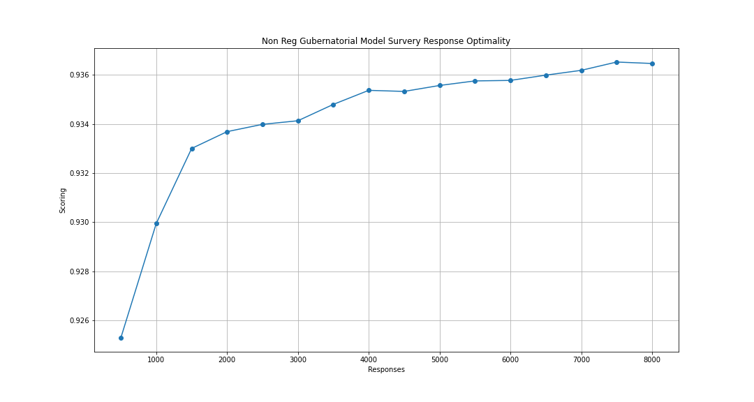
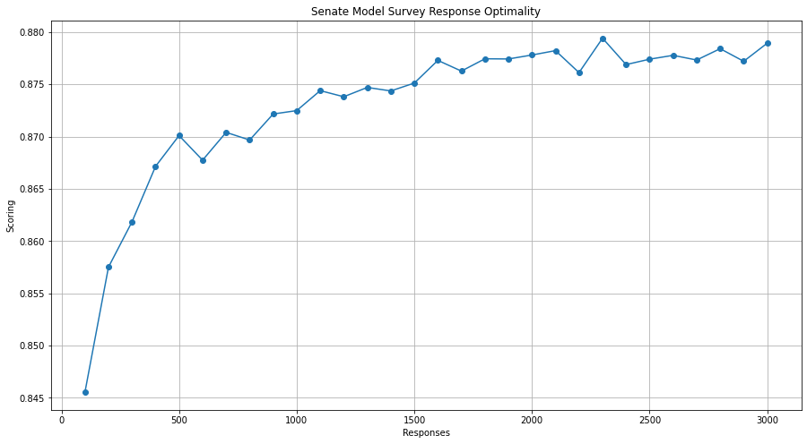
Findings:
Senate and Gubernatorial Teams
Governor Model
Accuracy rate of near 88% reached at an n size of ~2300.
Accuracy of 93% possible with n size of 1000.
Senate Model
Diminishing returns in accuracy after an n size of 4000.
Accuracy of 87% possible with an n size of as small as 500.

Slide 9

Conclusions
Results suggest that we can still get decent accuracy rates with smaller (sometimes significantly so) sample sizes. However…
…is the same pattern repeated for accuracy at a more granular level? For example, good topline accuracy rates but perhaps less so for specific demographic groups or regions with models trained on smaller sample sizes
…related to the above point, small sample size can exacerbate issues with regards to categories (eg. states) with overly small samples. Could MRP help ameliorate these problems?

Slide 10
Q & A

